Slide 1
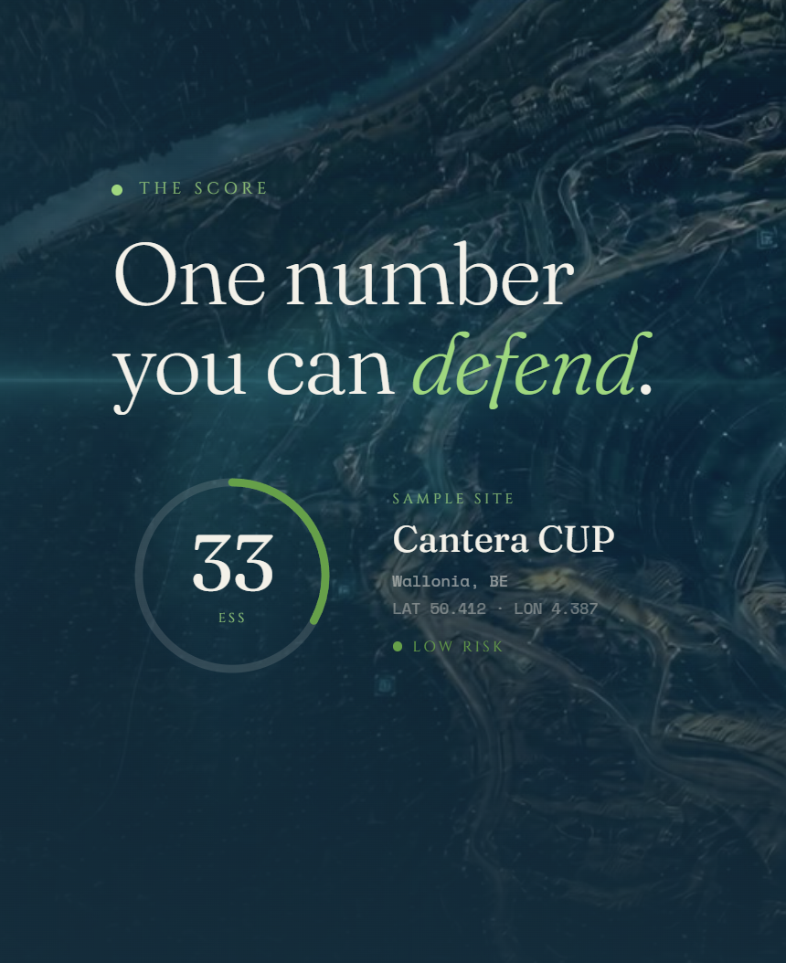

ENVIRONMENTAL INTELLIGENCE
Sustainability, seen from the sky.
We turn free satellite data into a clear, sourced read on the health of every site you own.
Sources Sentinel · Landsat
Frameworks CSRD · EU Taxonomy · EUDR
Notes:
Open on the gap. ABIL turns free satellite data into continuous, sourced environmental evidence for every site a company owns. The snapshot shows the product in one glance.

Slide 2
THE GAP
Reported once a year. Observed all year.
Companies share their impact once a year. The people they answer to now watch the same sites all year.
THE REPORT
THE WATCH
Once a year
All year long
A PDF, sent once. Already old the day it ships.
The same sites, watched from space every day.
WHERE THE COST LANDS
Fines
Blocked permits
Lost loans
When what you report does not match what is seen.
Licences held up for environmental reasons.
Money pulled or made dearer as lenders watch from space.
Notes:
Companies share their impact once a year. The people they answer to now watch the same sites all year. That gap is where fines, blocked permits and lost loans come from.

Slide 3
WHAT ABIL DOES
A living check for every site.
01
Free data in
Satellite data from Sentinel and Landsat, pulled in every day.
Impact
68/100
Physical exposure
81/100
02
Scores
How much the site affects the area around it.
How exposed it is to climate and nature risk.
Four clear numbers for each site.
03
Ask
74/100
−12%/2yr
Plain answers, straight from the data.
Nature nearby
Change
How rich and sensitive the nearby nature is.
How the site has shifted over the last 2 years.
04
Report
One click to a report regulators accept.
Notes:
Not a prettier map. Free data in, four scores for each site, ask in plain words, report out. Know your one number per axis: Impact, Exposure, Nature nearby, Change.

Slide 4

THE ANALYST
Just ask Billy.
YOU
Which of my sites is most at risk, and why?
Billy answers in plain words, using only the data, and shows the proof.
Billy
The same engine that answers live on our site.
Site B14 (UCP2) is most at risk, at 81 out of 100 . It has lost 12% of nearby tree cover since 2024, and water stress is rising.
TRY ASKING
Which sites breach permit limits?
Sentinel 2 · 18 May 2026
12% less tree cover in 2 years
What changed this quarter?
confidence 0.94
Show my EUDR exposure
Notes:
Show, do not tell. Open the site, scroll to Billy and ask which site is most at risk and why. A real, sourced answer appears, using only the data.

Slide 5
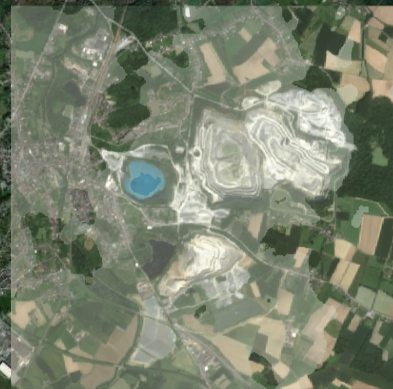
WHY IT HOLDS UP
It stops being satellite data and becomes defensible evidence.
Two things make a score stand up: it is traceable to the exact reading, and it maps to the rules that decide permits and money.
1
Traceable to the source
2
Mapped to the rules that matter
LIVE · B14
CSRD
✓ supported
EU Taxonomy
✓ supported
Report your impact, backed by real measurements.
Show no major harm, asset by asset.
PHYSICAL EXPOSURE
81/100
EUDR
✓ supported
Permit limits
✓ supported
Prove your sites are free of deforestation.
Check each site against its legal limits.
SOURCE
Sentinel 2 image · which image it came from
DATE
18 May 2026 · when it was measured
CONFIDENCE
0.94 · how sure the model is
✓
One click writes a report regulators accept, with a clear trail back to the source.

Slide 6
PRICING
Free data and light computing keep our costs low, so cover grows with your portfolio instead of fighting it.
Priced per site, from one place to a whole portfolio.
Single sites
MOST CHOSEN
Global portfolios
Starter
Operators · insurers · lenders
Global
€6,000/yr
Regional
€150,000/yr
WHAT IS INCLUDED
€60,000/yr
Portfolio map and scores
✓
✓
✓
Standard reports and email alerts
✓
✓
✓
Monthly updates and alerts
–
✓
✓
Report packs for regulators
–
✓
✓
AI analyst and API
–
✓
✓
Unlimited sites
–
–
✓
Supply chain tracking
–
–
✓
A dedicated engineer
–
–
✓
Open data in. Evidence out.
Get started →
Get started →
Get started →
Notes:
Priced per portfolio, from six thousand euros a year for a single operator up to a global plan. Free data and light computing keep our cost per site near zero, so margins grow.

