Slide 1












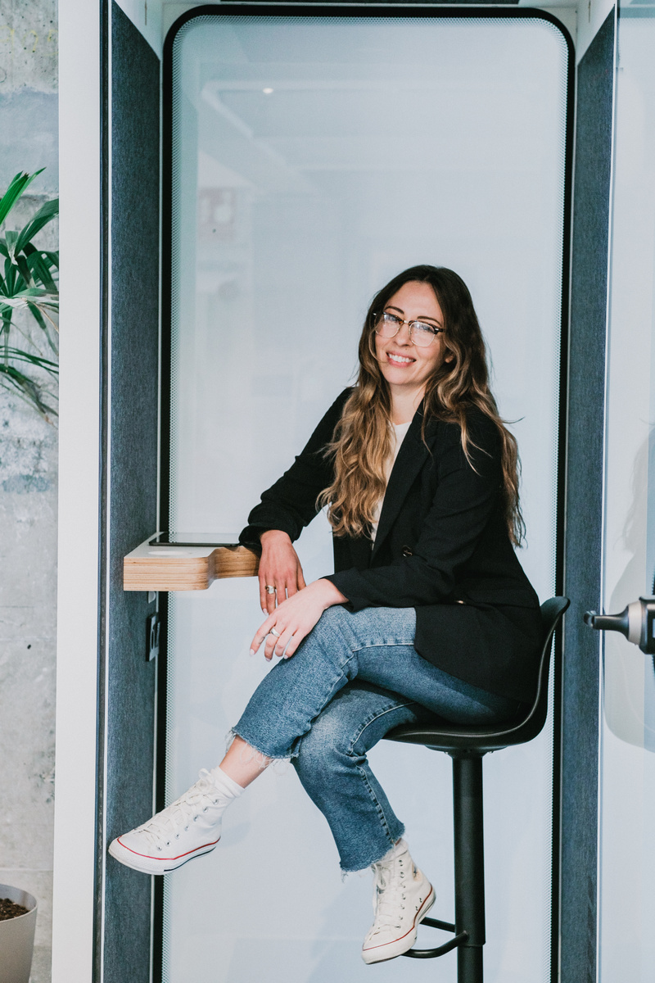




ISU 2026
PRANA
The platform that connects founders with capital and the tools to get there
Give Life to Your Ideas
prana.vc

Slide 2






PRANA
The Problem
One barrier stops every founder equally

Slide 3


PRANA
The Solution
Don't worry — Prana has the solution.
We connect you directly with Angel Investors, Incubators & Accelerators, and Crowdfunding (starting at as low as €100). All in one place — without you having to knock on doors alone.

Slide 4
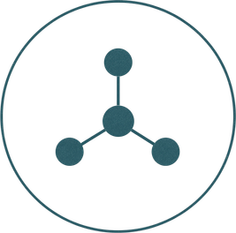




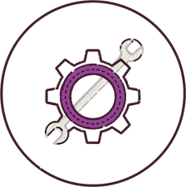







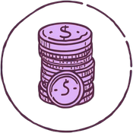


Benefits
  Direct access to angels, incubators & crowdfunding
  AI tools & experts to build your pitch & MVP
  Real visibility — monthly progress seen by investor
  An active community around your idea
  AI agents for business plan, marketing & research

Slide 5
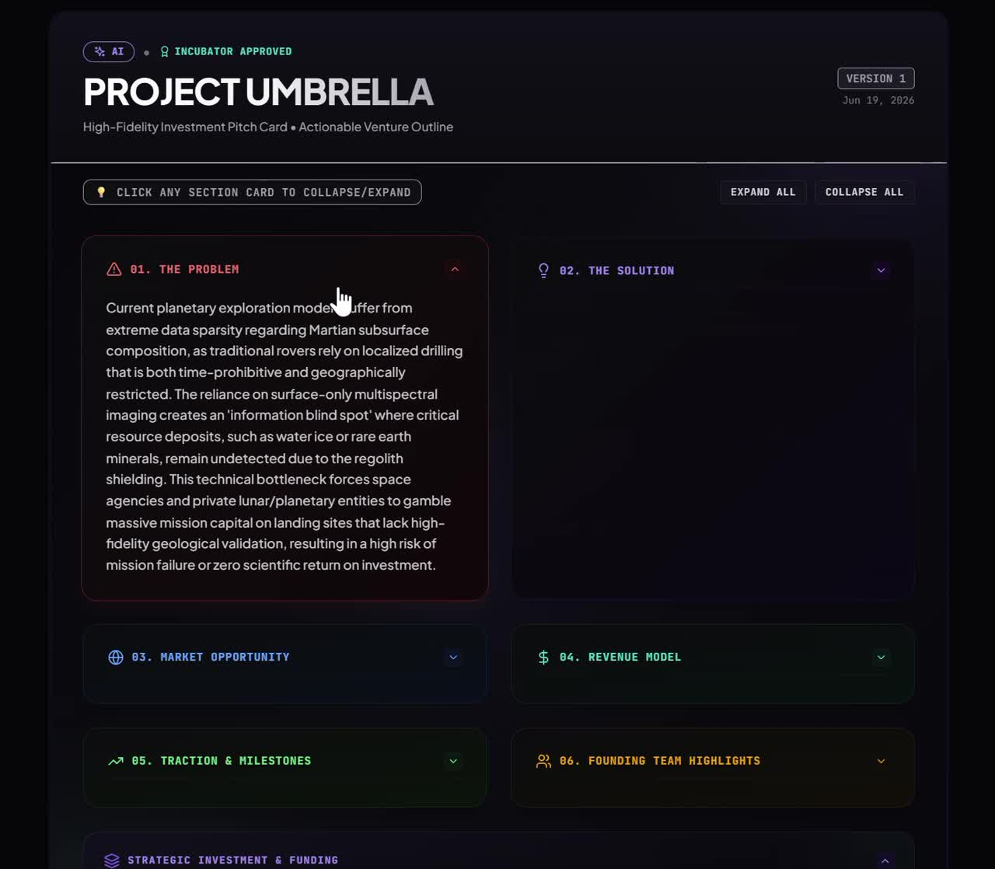
All the
Advantages
✓ Generate Pitches for your business idea and connect to angels, incubators & people genuinely interested your idea.
✓ Marketing and exposure — get seen, not just exist
✓Step-by-step guided roadmap to become investment-ready
✓ Get realtime feedback on your progress
✓ We get paid when you win (5% on secured investment)

Slide 6
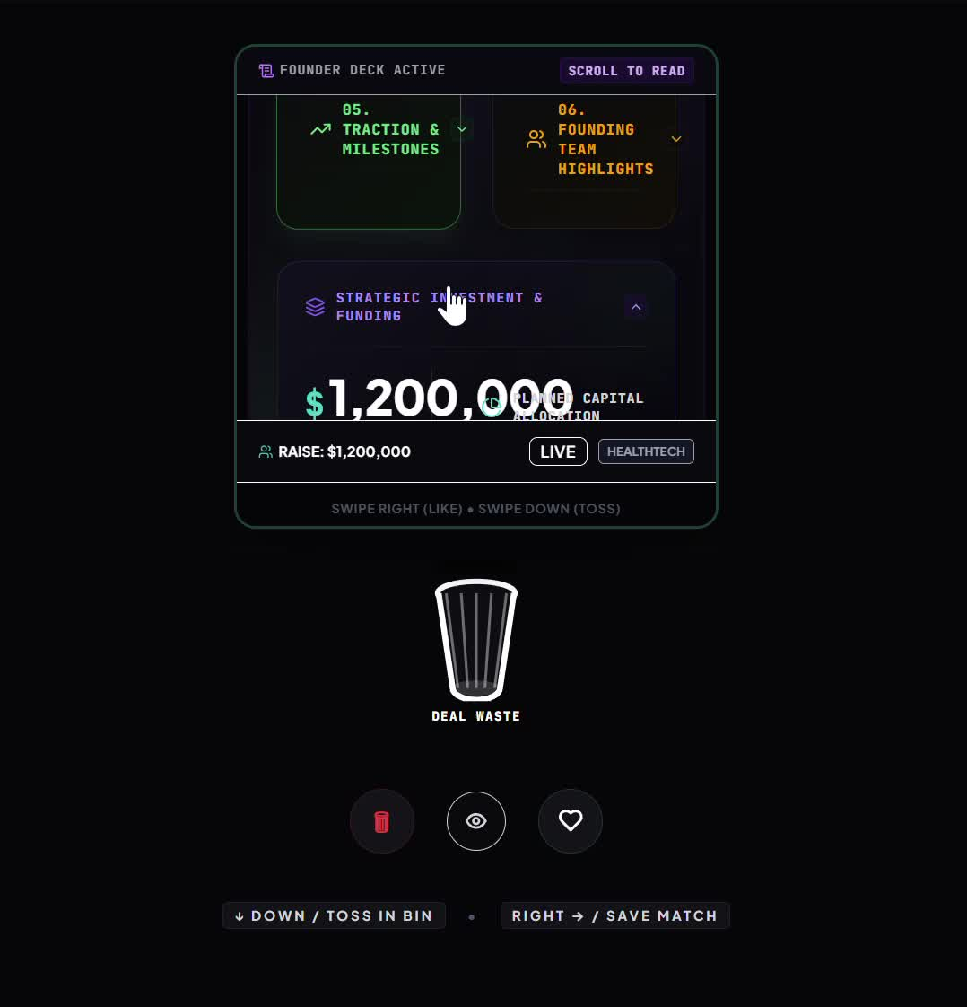
All the
Advantages
✓ Generate Pitches for your ideas.
✓ Connection to angels, incubators & people genuinely interested your idea.
✓ Marketing and exposure — get seen, not just exist
✓Step-by-step guided roadmap to become investment-ready
✓ Get realtime feedback on your progress
✓ We get paid when you win (5% on secured investment)

Slide 7
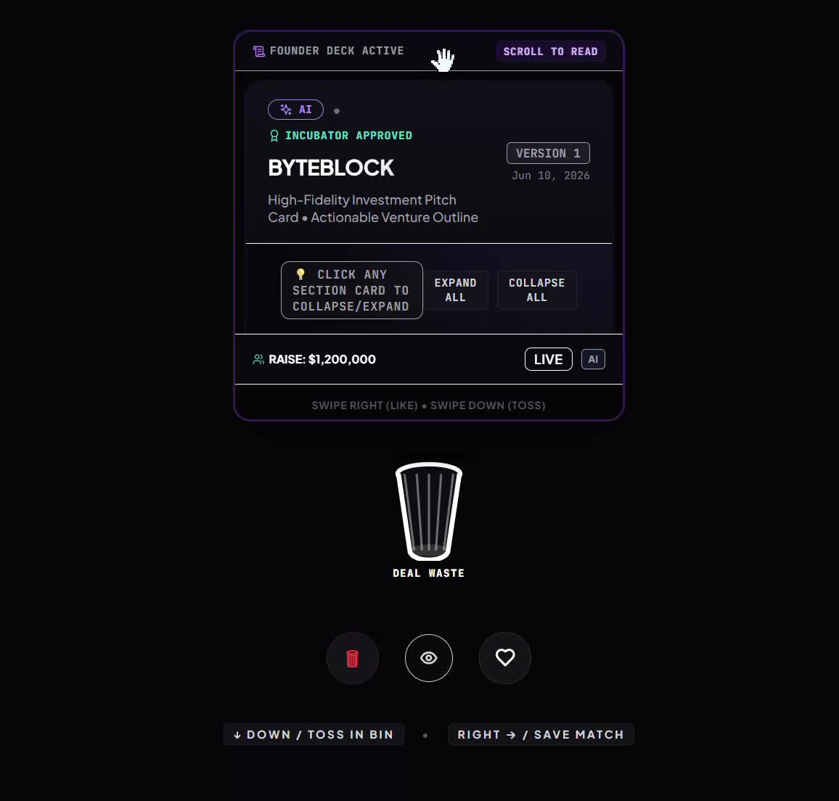
All the
Advantages
✓ Generate Pitches for your ideas.
✓ Connection to angels, incubators & people genuinely interested your idea.
✓ Marketing and exposure — get seen, not just exist
✓Step-by-step guided roadmap to become investment-ready
✓ Get realtime feedback on your progress
✓ We get paid when you win (5% on secured investment)

Slide 8
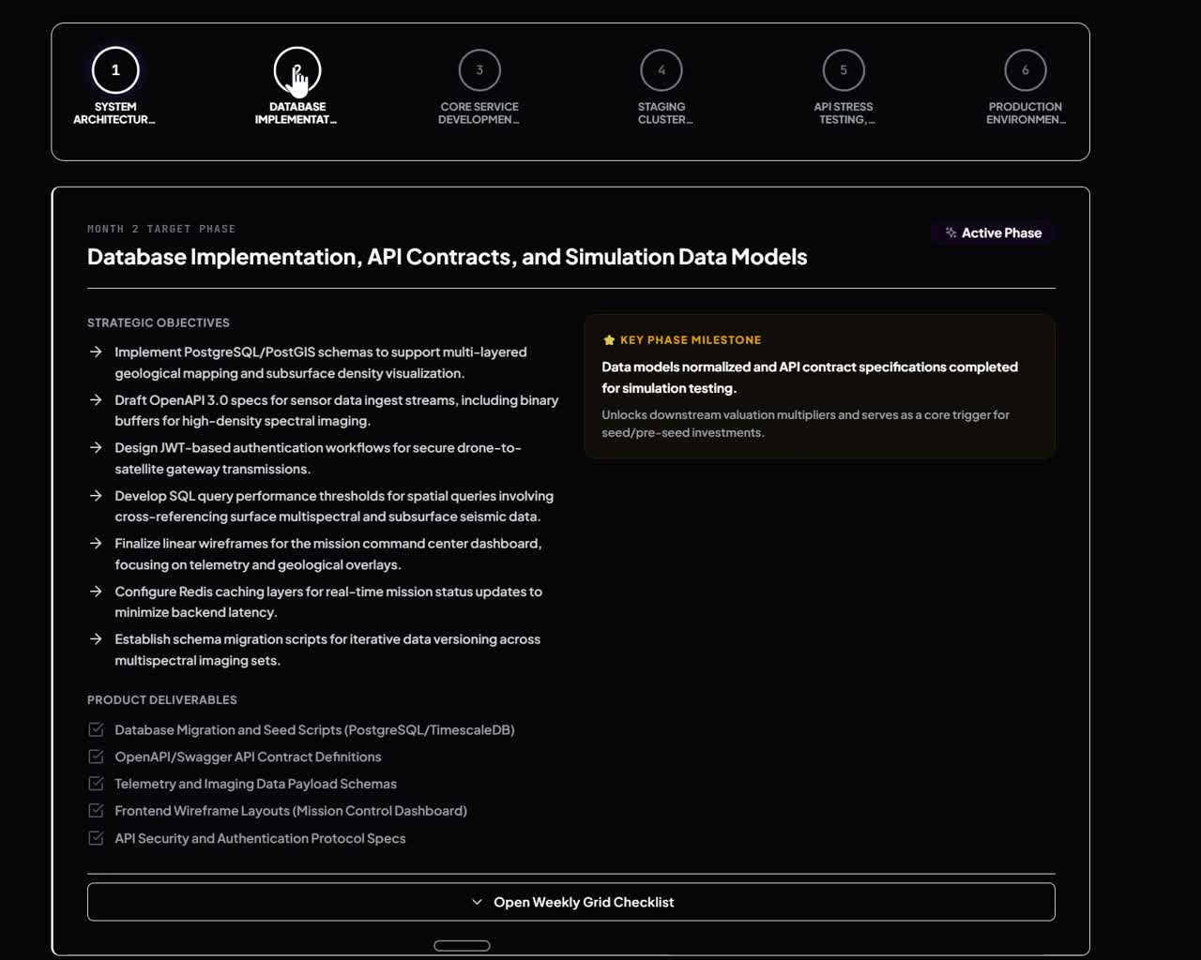
All the
Advantages
✓ Generate Pitches for your ideas.
✓ Connection to angels, incubators & people genuinely interested your idea.
✓ Marketing and exposure — get seen, not just exist
✓Step-by-step guided roadmap to become investment-ready
✓ Get realtime feedback on your progress
✓ We get paid when you win (5% on secured investment)

Slide 9




PRANA
Business Model
How We Make It Work
Free for Founders
We only win when you win — 5% only when you secure investment through Prana. If you don't raise capital, you owe us nothing.

Slide 10
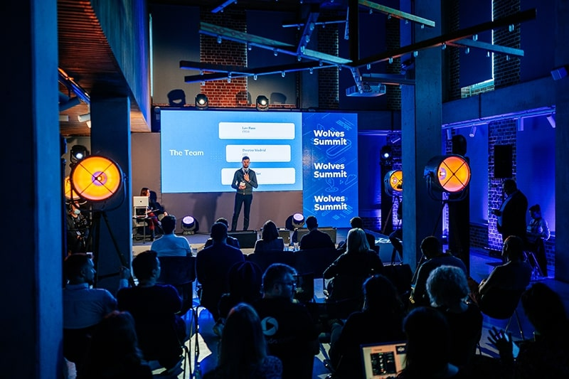

PRANA — Why Choose Us
Why Choose
Prana
Other paths make you choose one road — an incubator, an angel, or a crowd campaign. Prana gives you all three at once, for free, with access AI-powered tools no one else offers.

Slide 11



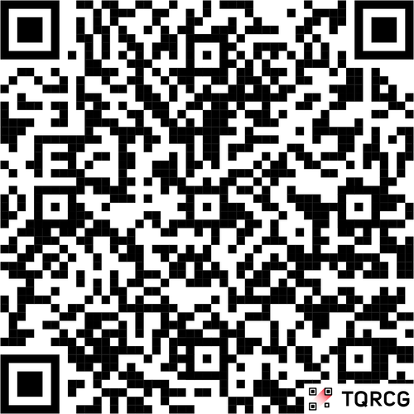


Let's Build
Something Real

